Slide 1

Time Series Analysis of Phenometrics and Long-Term Vegetation Trends for the Great Plains Ecoregion using Moderate Resolution Satellite Imagery
J.M. Shawn Hutchinson, Hilda Onuoha, and Austin R. Braget Department of Geography, Kansas State University
Manhattan, Kansas 66506 USA

Slide 2
Questions
How have grasslands in the Great Plains changed over the period 2001-2017?
How might these changes impact the provision of selected grassland-related ecosystem services?

Slide 3
Objectives
Process a time series of MOD13Q1 images to assess trends in grassland biomass production as measured with NDVI/EVI. Develop and approach to identify “anomalous” digital number values for this proxy to inform near real-time management.
Process time series of MOD13Q1 images to assess grassland phenology. Extract multiple phenometrics and assess their temporal trends and spatial variation over the period 2001-2017.
Develop a validation procedure for Objectives 1-2 using imagery from the PhenoCam Network.
Using an improved understanding of grassland development and production in the past, and forecasted into the future, assess the impact of changing grassland conditions on the provision of a subset of ecosystem services.

Slide 4
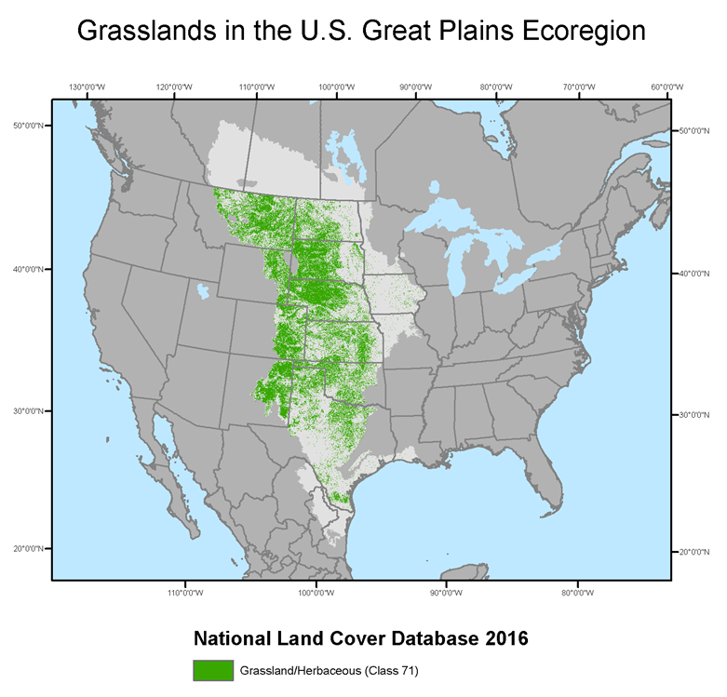
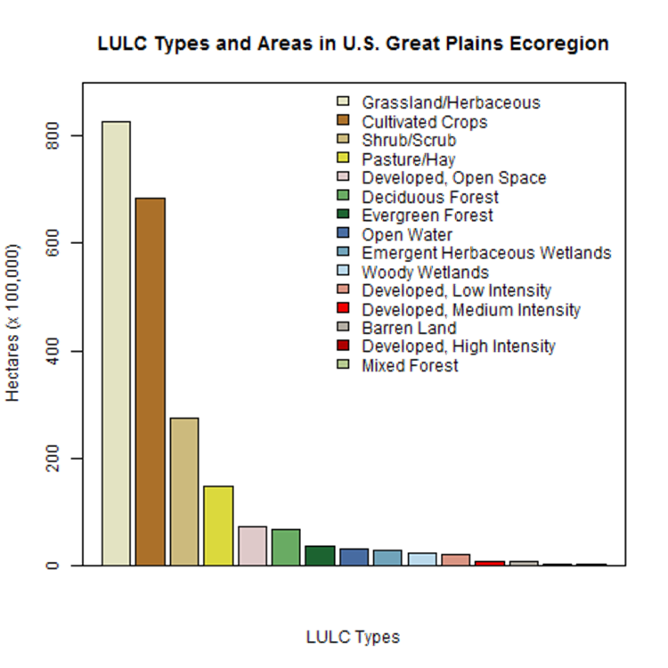
Study Area Great Plains Level 1 Ecoregion – United States

Slide 5
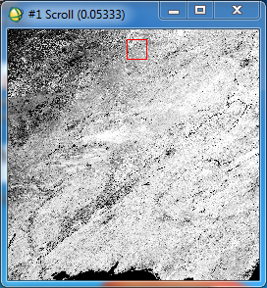
Monitoring Surface Greenness MODIS MOD13Q1 16-day NDVI composite image from August 13-28, 2015
Collect, process, and analyze MODIS Terra 16 day composite NDVI images (MOD13Q1).
6.25 ha (15.5 ac) pixels
23 images per year (since 2001)
Consistent and reliable long-term coverage.

Slide 6
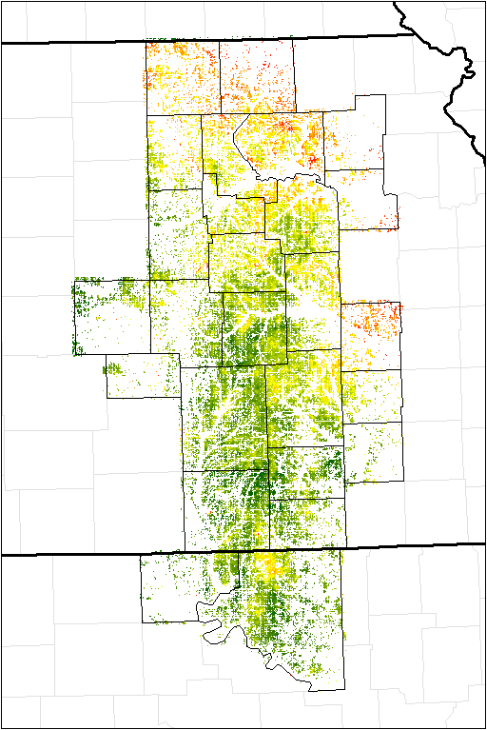
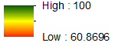
MODIS Pixel Reliability – GOOD Class

Slide 7
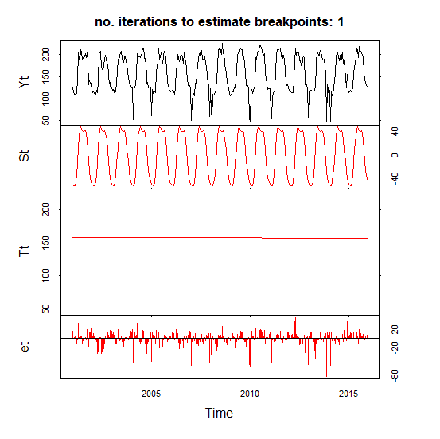
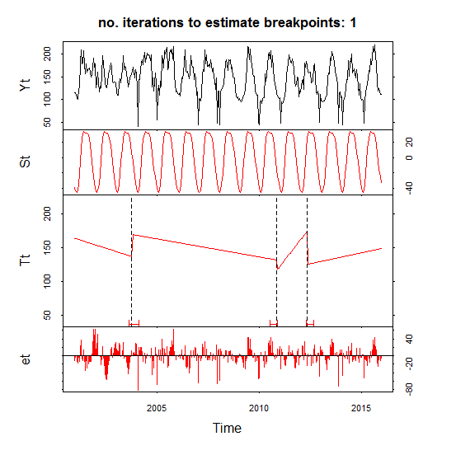
Detecting Trends in Greenness Verbesselt, J., Hyndman, R., Newnham, G., Culvenor, D. 2010. Detecting trend and seasonal changes in satellite image time series. Remote Sensing of Environment 114(1):106-115.
Breaks For Additive Seasonal and Trend (BFAST) change detection algorithm; decomposes time series datasets into seasonal, trend, and noise components.
Total of 345 16-day composite NDVI images acquired by MODIS Terra from 2001-2015 were analyzed.

Slide 8
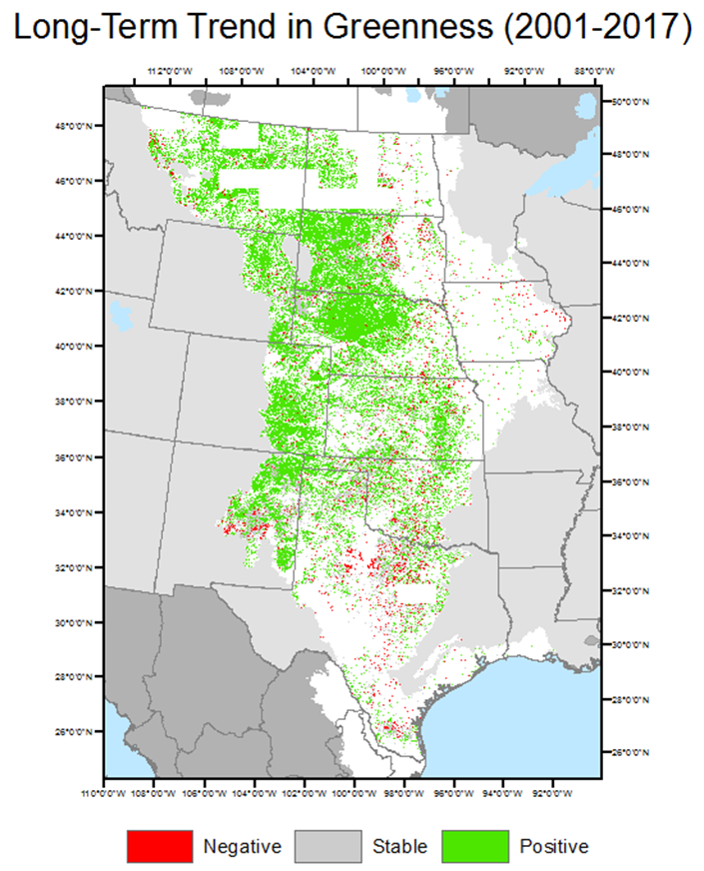
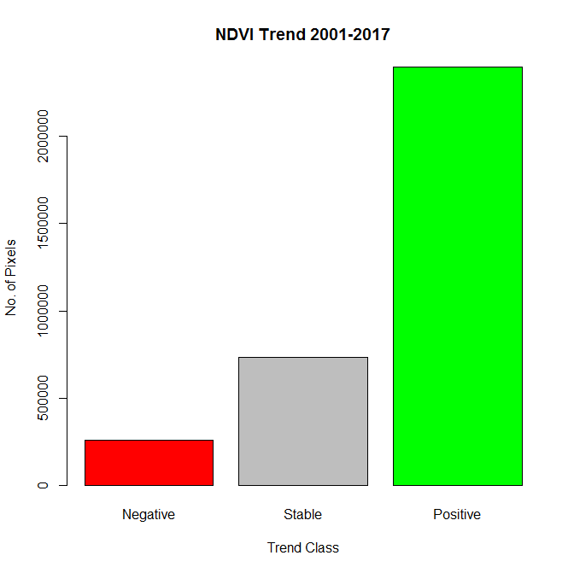
BFAST-Detected Trends in Greenness, 2001-2017 MODIS MOD13Q1 16-day NDVI composite image time series; 391 total images

Slide 9
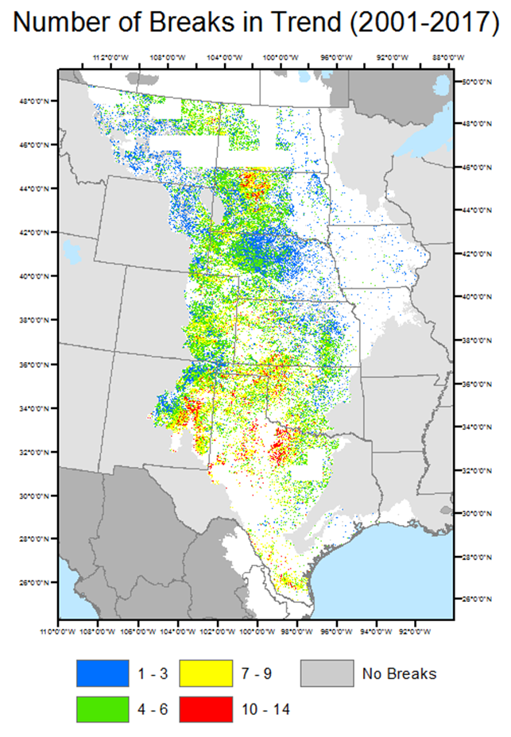
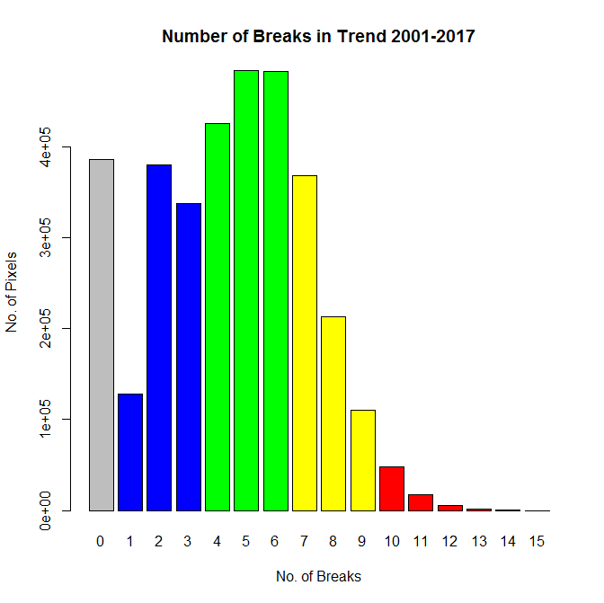
BFAST-Detected Significant Breaks in Trend, 2001-2017 MODIS MOD13Q1 16-day NDVI composite image time series; 391 total images; maximum of 1 break per year detected

Slide 10
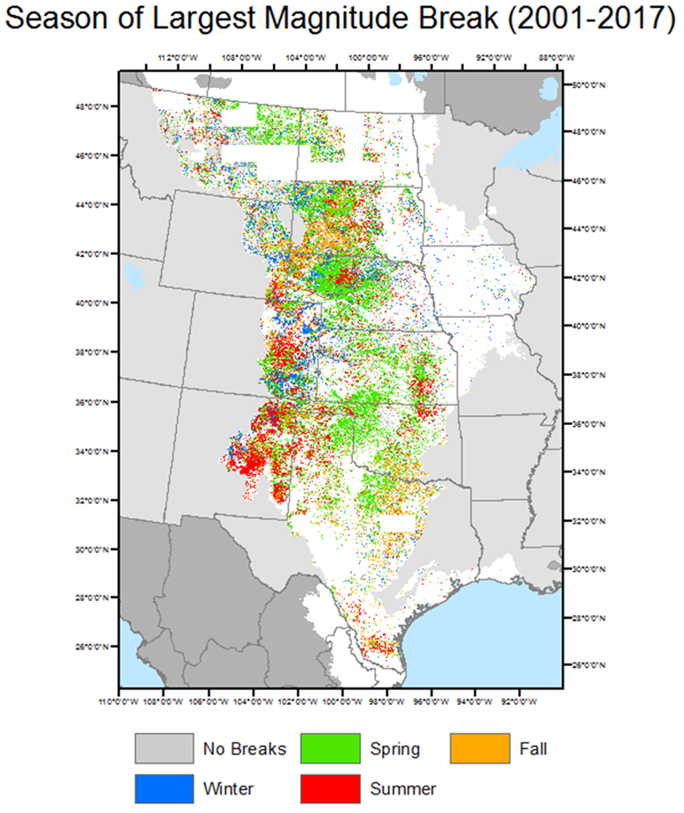
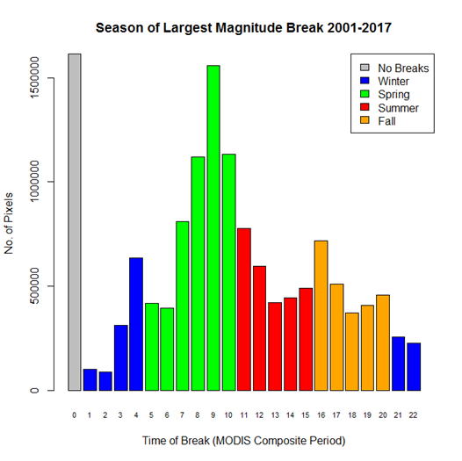
BFAST-Detected Season of Largest Magnitude Break, 2001-2017 MODIS MOD13Q1 16-day NDVI composite image time series; 391 total images; maximum of 1 break per year detected

Slide 11
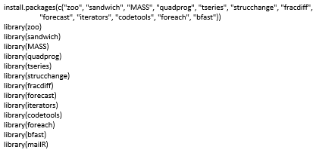
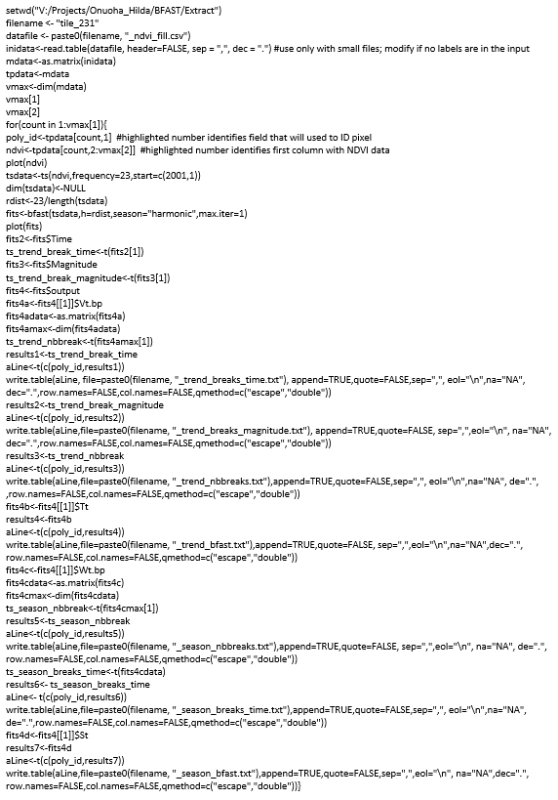

Slide 12
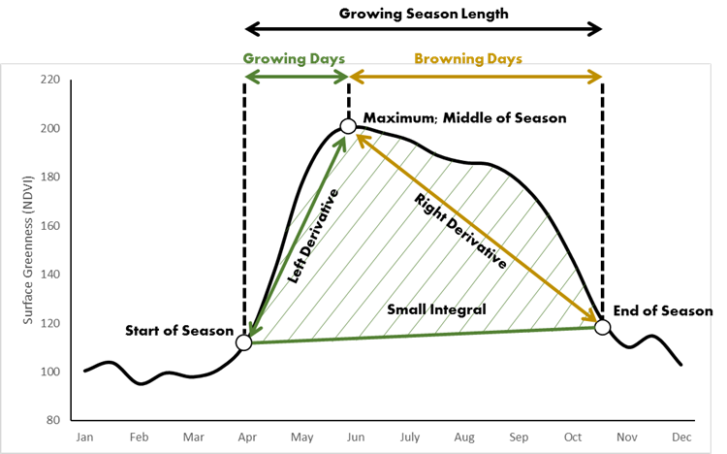
Land Surface Phenology Study of the natural seasonal cycle of plant life using sensor data.
Phenometrics measure key stages of plant development
13 distinct phenometrics assessed

Slide 13
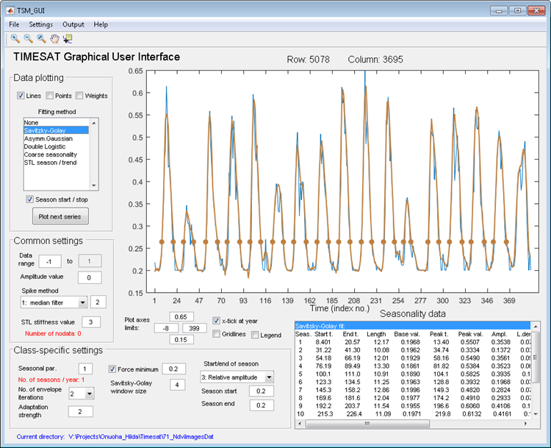
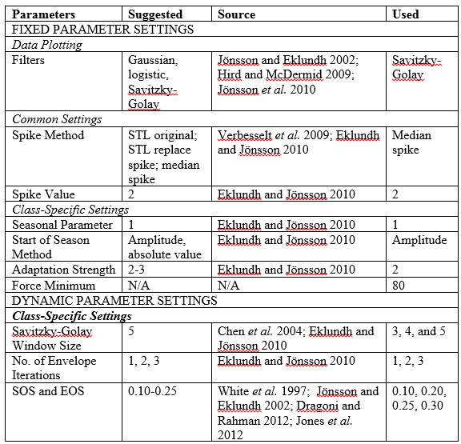
Phenometric Extraction with TIMESAT Eklundh, L., and Jönsson, P. 2010. Timesat 3.0 Software Manual. Lund University, Sweden.

Slide 14
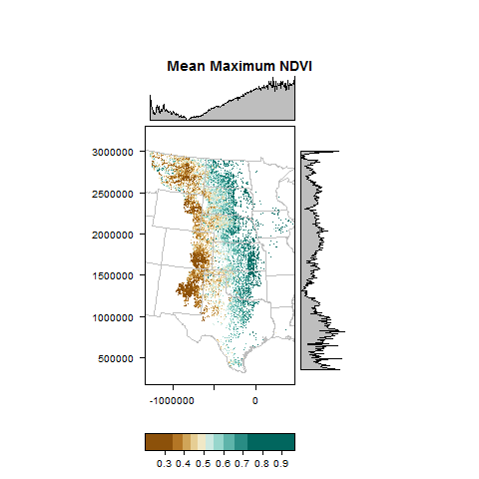
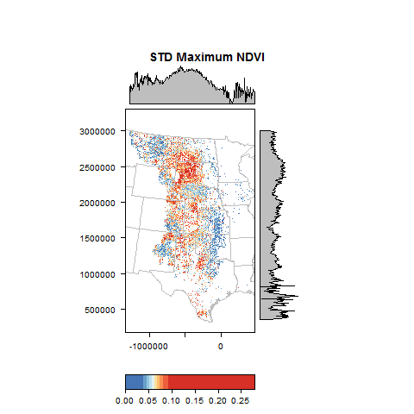
Mean Maximum NDVI, 2001-2015

Slide 15
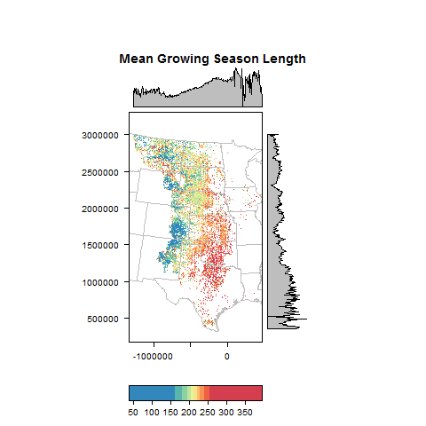
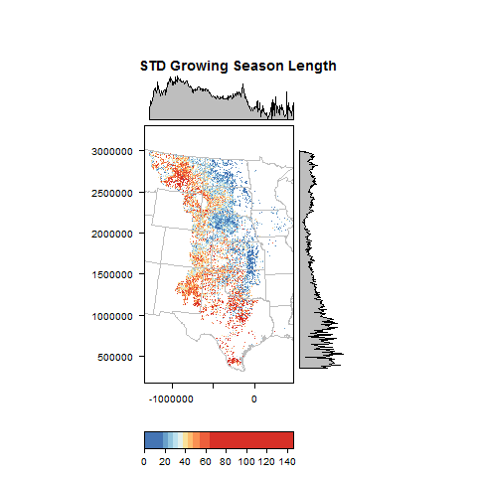
Mean Growing Season Length, 2001-2015 Numbers represent “composite period days” – multiply by 16 to obtain season length in days.

Slide 16
Time Series Analysis of Phenometrics and Long-Term Vegetation Trends for the Great Plains Ecoregion using Moderate Resolution Satellite Imagery
J.M. Shawn Hutchinson, Hilda Onuoha, and Austin R. Braget Department of Geography, Kansas State University
Manhattan, Kansas 66506 USA

Slide 17
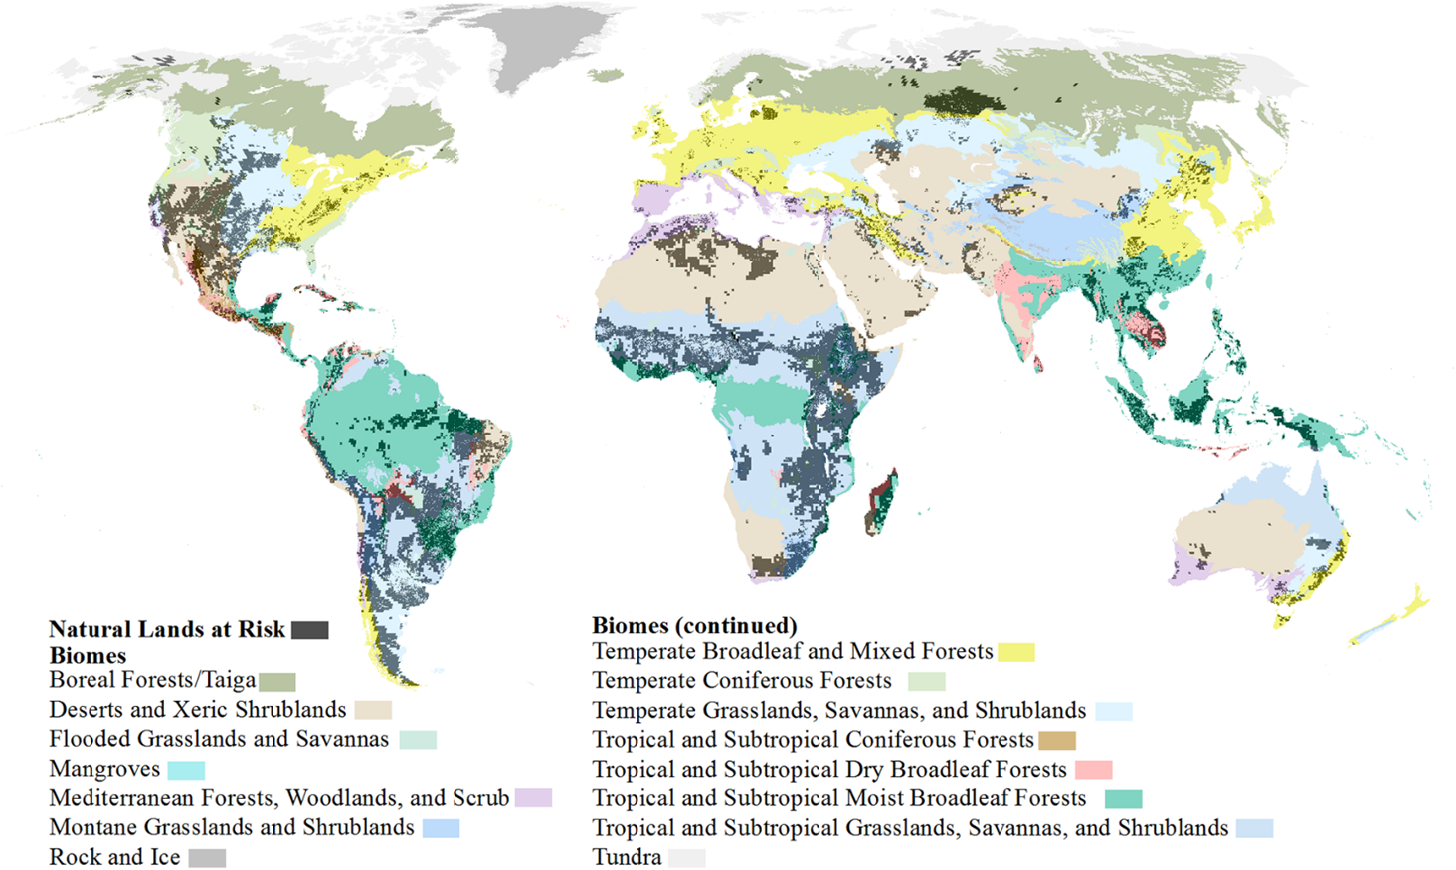
Oakleaf, J.R., C.M. Kennedy, S. Baruch-Mordo, P.C. West, J.S. Gerber, L. Jarvis, J. Kiesecker. 2015. A world at risk: Aggregating development trends to forecast global habitat conversion. PLOS One doi: 10.1371/journal.pone.0138334

Slide 18
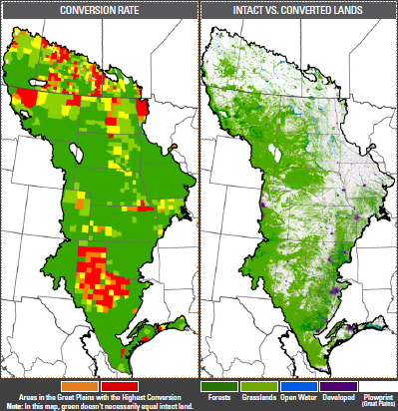
World Wildlife Fund. 2016. Plowprint Annual Report 2016. Northern Great Plains Program, Bozeman, MT.
Notes:
Between 2009-2015, 53 million acres of grassland converted across the Great Plains region, a 2% annual loss that sums to an area rivalling that of the State of Kansas. In 2014, the Great Plains lost more acres of grassland to conversion than the Brazilian Amazon.

Slide 19
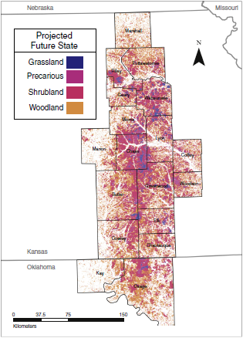
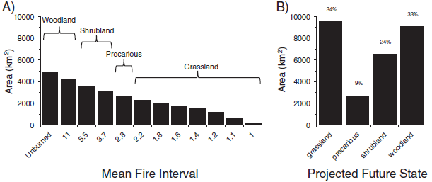
Ratajczak, Z., J.M. Briggs, D.G. Goodin, L. Luo, R.L. Mohler, J. Nippert, and B. Obermeyer. 2016. Assessing the potential for transitions from tallgrass prairie to woodlands: Are we operating beyond critical fire thresholds? Rangeland Ecology & Management 69(4): 280-287.

Slide 20
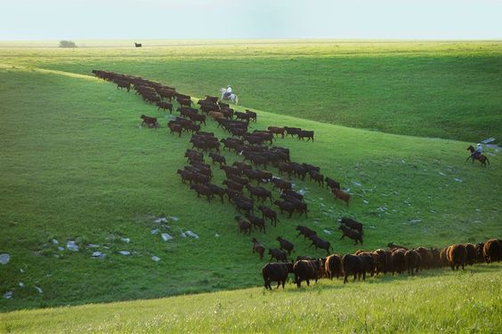
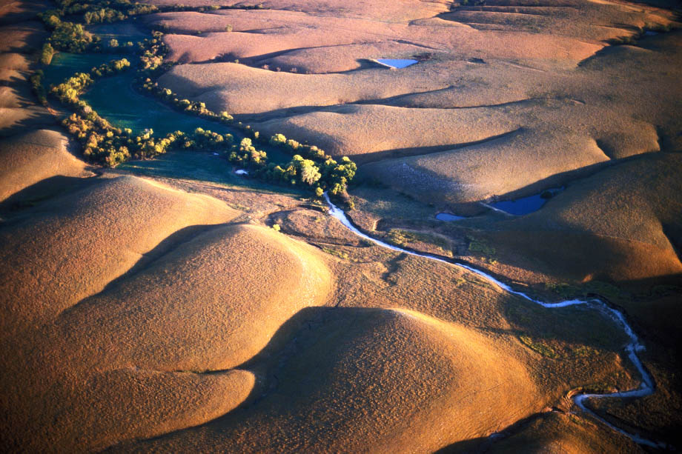
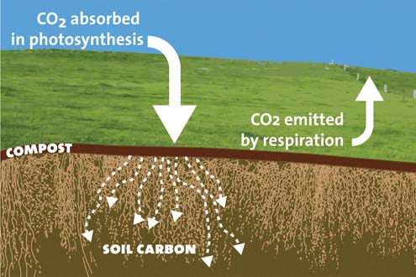
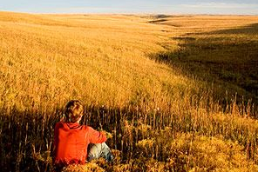
Grassland Ecosystem Services
Fodder for Livestock
Food and Medicine
Clean Water Flood Prevention
Recreation Spiritual and Aesthetics

Slide 21
Grassland Ecosystem Service Values Dodds, W.K., K.C. Wilson, R.L. Rehmeier, G.L. Knight, S. Wiggam, J.A. Falke, H.J. Dalgleish, and K.N. Bertrand. 2008. Comparing ecosystem goods and services provided by restored and native lands. BioScience 58(9):837-845.
Ecosystem Service Category | Value $(2004)/ha/yr
 | Native | Restored
Gas Regulation | 7 | 6
Disturbance Regulation | 7 | 7
Water Supply | 28 | 19
Nutrient Cycling | 22 | 15
Soil Erosion Control | 241 | 175
Agricultural Commodities | 3,853 | 2,490
Biodiversity | 46 | 50
Recreation | 1,003 | 1,003
Total, $/yr | $1,574 billion

Slide 22
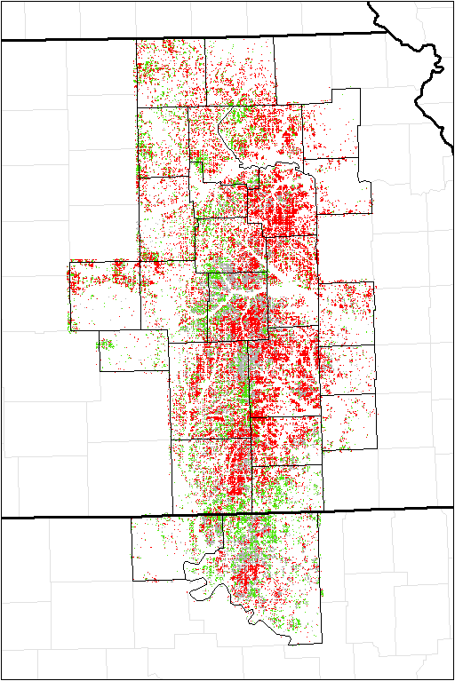
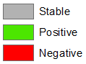
BFAST-Detected Trends in Greenness, 2001-2015 MODIS MOD13Q1 16-day NDVI composite image time series; 345 total images

